Slide 1
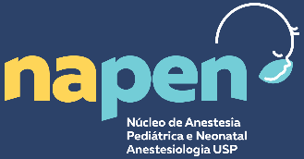
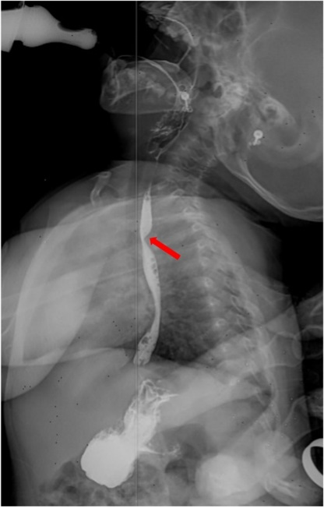
Anesthetic management for surgical correction of dysphagia lusoria in a 2-year-old child
Fernando Cançado, Marina Munhoz, Herick Nascimento, Bruno Costa, Gabriel Sousa, Luiza Lino, Vinicius Quintão, Ricardo Carlos.
Instituto da Criança e do Adolescente, Hospital das Clínicas HCFMUSP, Faculdade de Medicina, Universidade de São Paulo, São Paulo, Brazil.
Introduction: Dysphagia lusoria is a rare condition in which an anomalous right subclavian artery (ASRA) obstructs the esophageal lumen, leading to progressive dysphagia. Surgical treatment is recommended for symptomatic patients. The most common correction procedure involves a bypass and ligation on the emerging ARSA, or simply a ligation, commonly performed by open surgery in children.
Case Report: A 10 kg 2-year-old girl with a history of progressive dysphagia since 4 months of age, leading to several hospitalizations for aspiration pneumonia, was admitted for a left thoracotomy and ligation of the ARSA, after diagnosis of dysphagia lusoria (Figure 1).
Case Report (continuing): At the pre-anesthetic evaluation, passive smoking and chronic inhaled formoterol use for bronchitis were noted. Preoperative lab tests collected on admission were within normal ranges. Anesthetic management included two peripheral access, central and arterial lines, and an epidural for postoperative analgesia.
Monitorization of perfusion, using a pulse oximeter in both arms, was indicated. Anesthesia was maintained with sevoflurane. By default, our monitor's pulse plethysmography wave amplitude is 40%. After the ligation, the wave on the right arm reduced; however, it was still present when the amplitude was increased to 80%. The limb remained well-perfused at physical examination. The surgical procedure was uneventful. The patient was extubated, and the arterial line was removed. The child was sent to the PACU for one hour and then to the ward. The patient remained hospitalized for a week.
Conclusion: This surgical procedure required us to prepare for multiple adverse situations, such as the risk of ischemia, ventilatory changes due to surgical manipulation, major bleeding, and hemodynamic changes.
Bilateral peripheral pulse oximeter plethysmography was our strategy to evaluate limb perfusion after the ligation. In children, ligation is the procedure of choice, and perfusion of the limb will be guaranteed by ipsilateral vertebral arteria, bypassing through the circle of Willis.
The epidural anesthesia was influential in pain management. Since the surgery was uneventful and the right upper limb remained well-perfused, both anesthesia and surgery teams opted for early extubation and no need for postoperative intensive care.
Figure 1. Barium swallow test showing evidence of obstruction
Reference: Epperson MA and Howell R. Curr Opin Otolaryngol Head Neck Surg. 2019.

