Slide 1
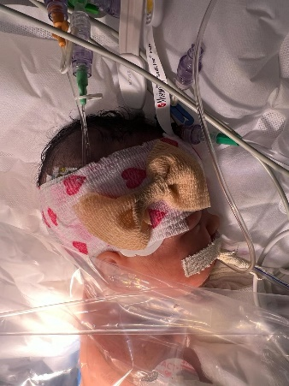
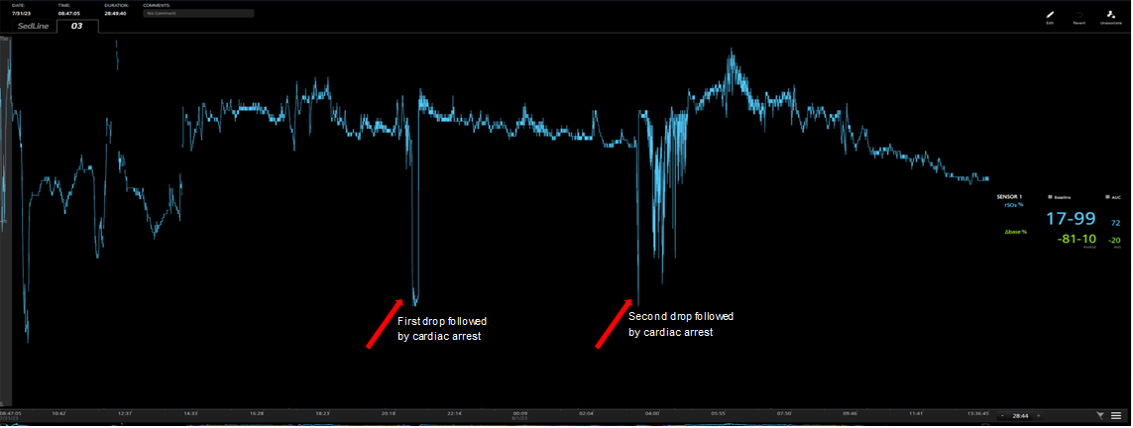
Intraoperative Cardiac Arrest Documented by NIRS in a Newborn with Coexisting Congenital Diaphragmatic Hernia and Esophageal Atresia/Tracheoesophageal Fistula
Bruna Klauck, Suzana Teruya, Hellen de Lima, Gabriel Sousa, Rafael Pereira, Tiago Freitas, Vinícius Quintão, Ricardo Carlos.
Instituto da Criança e do Adolescente, Hospital das Clínicas HCFMUSP, Faculdade de Medicina, Universidade de São Paulo, São Paulo, Brazil.
Introduction: Congenital diaphragmatic hernia (CDH) and esophageal atresia with type C tracheoesophageal fistula (EA/TEF) are rare neonatal pathologies with an incidence of 1:5000 and 1:2000, respectively. Its concurrence in the same patient is detailed by few reports in the literature and is associated with high mortality.
Case Report: A 6-day-old female, 2,230 Kg, ASA 4, with coexisting CDH and EA/TEF was admitted from the NICU to the OR for CDH repair. The patient was in fair general condition on physical examination, with jaundice grade 4/4, well-perfused, intubated (3,0 uncuffed ETT) on standard mechanical ventilation, sedated with fentanyl and dexmedetomidine. Auscultation showed reduced breath sounds on the left side. Pre- and post-ductal oxygen saturation was 90% and 94%, respectively. Chest/abdomen X-ray showed herniation of the stomach into the left hemithorax. Transthoracic echocardiogram showed an ejection fraction of 72%, CIA, PCA, and pulmonary hypertension (PASP = 50 mmHg). On admission she was on milrinone and noradrenaline infusions. The patient was further monitored with ECG, end-tidal CO2, noninvasive blood pressure, EEG, near-infrared spectroscopy (NIRS) (Figure 1), rectal temperature, and a Foley catheter. Anesthesia maintenance was done with sevoflurane, fentanyl, and dexmedetomidine, titrated accordingly with EEG. Suddenly after initiation of laparotomy, probably due to positive ventilation into to the fistula (Figure 2), it was noted a massive gastric distension and worsening of mechanical ventilation.
Figure 3. Cerebral oximetry during Congenital Diaphragmatic Hernia repair showing quicky drops (red arrows) corresponding to 2 cardiac arrests followed by ROSC.
Case Report (continuing): A quicky drop on the cerebral oximetry was observed (Figure 3), followed by cardiac arrest. She was resuscitated for 6 minutes. After ROSC, ligation of the gastric cardia was necessary to enable positive ventilation and correction of CDH. At the end of the procedure, after surgeons removed the ligation, we immediately noted another significant drop in the cerebral oximetry. The patient evolved into a new cardiac arrest for 5 minutes that only resolved with a new ligation. The patient was sent to the NICU intubated and sedated and with vasoactive drugs titrated. The ligation of the cardia was left in place for a further second approach for correcting the EA/ TEF after stabilization.
Figure 1. NIRS and EEG sensors
Conclusion: Despite the advances in monitorization and techniques, neonatal anesthesia remains challenging, especially when multiple pathologies are associated. Communication between the surgical team and quick actions are crucial to minimize possible long-term damages. Particularly in this case, we were able to document two episodes of severe drop in cerebral oxygenation. This case highlights the importance of having this monitoring more accessible, mainly in this particular population.
Figure 2. Tracheoesophageal fistula
Reference: (1) Olbrecht VA et al. Anesthesiology. 2018. (2) Hendrikx D et al. Eur J Anaesthesiol. 2022

