Slide 1
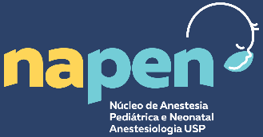
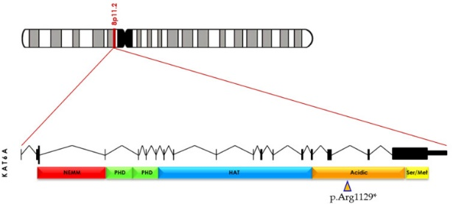
Perioperative Management for Several Major Procedures in a Child with a New Orphan Disease: the Arboleda-Tham Syndrome
Luiza Lino, Bianca Correa, Fernando Cançado, Suzana Teruya, Mariana Cabral, Octavio Dantas, Paula Albuquerque, Rafaela Machado, Gabriel Sousa, Vinícius Quintão, Ricardo Carlos
Instituto da Criança e do Adolescente, Hospital das Clínicas HCFMUSP, Faculdade de Medicina, Universidade de São Paulo, São Paulo, Brazil.
Introduction: The Arboleda-Tham Syndrome (ARTHS), also known as Autosomal Dominant Intellectual Disability-craniofacial Anomalies-cardiac Defects Syndrome, is a rare autosomal dominant disease first described in 2015. This genetic condition is caused by a heterozygous mutation in the KAT6A gene and is characterized by neuropsychomotor development delay, microcephaly, cardiac alterations, and gastrointestinal complications. The ARTHS is also associated with craniofacial abnormalities, which may cause a difficult airway approach.
1st
Transposition of the great vessels
2nd
Liver transplantation
3rd
Decompressive craniectomy
Cardiac cirrhosis
Seve thrombocytopenia
Hemorrhagic stroke
Arboleda-Tham Syndrome (ARTHS), a newly identified neurodevelopmental disorder, was first reported in 2015. It is associated with mutations in the KAT6A gene, which encodes the enzyme Lysine Acetyltransferase 6A located on chromosome 8. This enzyme plays a crucial role in various physiological processes. Pathogenic variants in KAT6A, inherited in an autosomal dominant manner, result in dysfunctional enzyme activity, leading to a spectrum of symptoms including global developmental delay, intellectual disability, craniofacial dysmorphism, hypotonia, motor delay, feeding difficulties, cardiac defects, and ocular anomalies. Despite its rarity, ARTHS ranks among the most common causes of undiagnosed syndromic intellectual disability.
Figure 2. Main major procedures
Figure 1. KAT6A is located at 8p11.2.
Case Report: A 3-year-old boy weighing 17 kg was diagnosed via exome sequencing with heterozygosity in the KAT6A gene (Figure 1). Clinical manifestations included microcephaly, long face, mandibular prognathism, midface retrusion, neurodevelopmental delay, and a history of corrected transposition of the great vessels. Following congenital cardiopathy correction surgery, he developed severe cardiac cirrhosis (congestive hepatopathy) necessitating liver transplantation. During the early postoperative period after liver transplantation, he experienced thrombocytopenia followed by a hemorrhagic stroke, leading to the need for a decompressive craniotomy (Figure 2). Subsequently, he exhibited worsening neurodevelopmental delay and swallowing difficulties, prompting the recommendation for a gastrostomy. Previous anesthesia procedures were complicated by difficult airway management, but no other complications were reported.
Case Report (continuing): The patient underwent gastrostomy via open laparotomy under general anesthesia. After standard monitoring, modified rapid sequence induction was performed, followed by successful endotracheal intubation using a McGrath video laryngoscope. Anesthesia was maintained with sevoflurane, and ultrasound-guided quadratus lumborum and transversus abdominis plane blocks were administered without complications. Postoperatively, the patient was transferred to the pediatric ICU for monitoring.
Conclusion: Arboleda-Tham Syndrome (ARTHS) presents unique challenges for pediatric anesthesiologists, particularly concerning craniofacial abnormalities and airway management. Given the likelihood of a difficult airway, we utilized a video laryngoscope for the initial intubation attempt to minimize complications. Additionally, prioritizing measures for prompt return to spontaneous ventilation post-extubation is crucial. We opted for an opioid-sparing approach with multimodal intravenous analgesia and abdominal wall blocks to manage pain effectively.
Reference: Arboleda et al. Am. J. Hum. Genet. 2015.

